Slide 1
Welcome to Art, Design and Humanities
Notes:
Welcome to the Faculty of Arts, Design and Humanities. It is one of the 4 faculties at DMU. The others being BAL, HLS and TECH.
Each Faculty has a Dean like me, with overall responsibility for how it runs, the quality of what is offered to the student and their achievement.
By belonging to a faculty, you are amongst other students and staff with similar interests as you, and become a mini community within the wider university community.

Slide 2
Leicester School of Architecture
School of Arts
School of Design
School of Fashion and Textiles
School of Humanities
Performing Arts alumnus Akram Khan, now a
world famous dancer and choreographer
Notes:
ADH, as we call it for short, has five Schools within it.
Every student is on a programme managed by one of the schools with its own Head of School - so you know where you fit in and it’s clear who is responsible for your development and progress.
Drama, dance, photography and video and fine art = Arts
Humanities = languages, history, English and creative writing.

Slide 3
Notes:
We undertake world leading research
The most recent Research league table placed our English department in the top ten best UK universities for research in that area. More specifically, our research in English Literature was ranked 4th highest, alongside Cambridge University.
50 per cent of our research within the humanities and creative disciplines achieved four stars. In case you’re wondering - 4 stars is the best you can get.
This picture shows a still from the BBC series Tudor Monastery Farm. Dr John Martin who researches in agrarian history, advised the BBC throughout the series. We are proud of the excellence of our teachers
A National Teaching Fellowship is one of the most prestigious awards for excellence in higher education teaching.
Our staff have been awarded 16 National Teaching Fellowships since the scheme began in 2000 – the second highest total nationwide.
Our links to and partnerships with Industry are a fundamental characteristic of our courses
For example our partnership with Leicester’s Curve Theatre enables us to showcase emerging talent and performers at DMU. We put on student productions, exhibitions and installations on their stage. And DMU is the only university outside the USA that Gap offers internships to, with students from our courses within the School of Fashion and Textiles being selected for summer placements.

Slide 4
Notes:
You will see as you venture around the campus today we have some fantastic facilities. In the last decade, we have invested £200 million in our campus. We are particularly proud of our workshops and studios – they are among the best equipped and most spacious of any higher education institution in the UK.
We have just started a further £90 million campus transformation project which will add to the modern, inspiring environment that our students deserve.
The centre-piece is an impressive new base for our Faculty – that will help DMU maintain its position as one of the foremost providers of creative higher education in the UK.
There will also be new eating areas, an improved Students’ Union and a beautiful area of parkland at the very heart of the campus.
Our extensive plans will also significantly improve our outdoor sports facilities.
You will be the first students to benefit from the new developments.
While we do all this exciting construction we have moved some of our courses into brand new accommodation. To be honest, the temporary homes are better than what they had before.
You will have a chance to see all this for yourself when you go and visit the Schools that you are interested in.

Slide 5
Notes:
Kimberlin Library - houses more than half a million publications, a wide range of DVDs, e-resources, thousands of electronic journals, over 500 networked PCs with printing, scanning and copying facilities incorporated, a café and Learning Zones. The library is open 24 hours a day during term time. You can even use our ‘@ccess anywhere’ service to use the library when you’re not there.
Our Learning Zones and bookable syndicate rooms provide space for group and individual work, and are equipped with workstations (PC and Mac), power for laptops, plasma screens, whiteboards and DVD facilities.
We have also made our Virtual Learning Environment (Blackboard) available online on your mobile or tablet through free Apps available for iPhone/iPod/iPad, Android and Blackberry. This gives you 24/7 access to your learning materials wherever and whenever you want them.

Slide 6
Faculty student advice centre
Personal tutors
Disability support
Student feedback
Notes:
Of course University is not just about learning. For many of you it will also be about making a transition from school, perhaps leaving home for the first time and taking responsibility for your own well-being. Whatever your personal circumstances, we pay a lot of attention to the support we are able to offer you during your time at DMU.
Faculty Student Advice Centre
The Student Advice Centre offers information and guidance on non-academic issues. This can include financial worries, special needs support or personal problems affecting study.
Academic Guidance Centre
The faculty’s Academic Guidance Centre runs workshops and one-to-one sessions on a variety of academic skills, including time management, effective reading, note taking, academic writing (essays, reports, dissertations), verbal presentations, and revisions and exams.
Personal Tutor
Every undergraduate student has a personal tutor who can offer guidance on a range of issues, including academic progress, coping with university life and preparing for your career. Disability support
Art, Design and Humanities provides support to students with disabilities. The Faculty Student Support Co-ordinator is available to discuss specific support requirements, and to ensure that support is in place during your studies.
Placements unit
We have a placements unit within the faculty, giving access to hundreds of placement opportunities, one-to-one CV advice and interview preparation, a range of training sessions and support from a dedicated tutor throughout your placement. This all helps you to kick-start your CV, acquire professional skills, boost your confidence and improve your interpersonal skills.

Slide 7
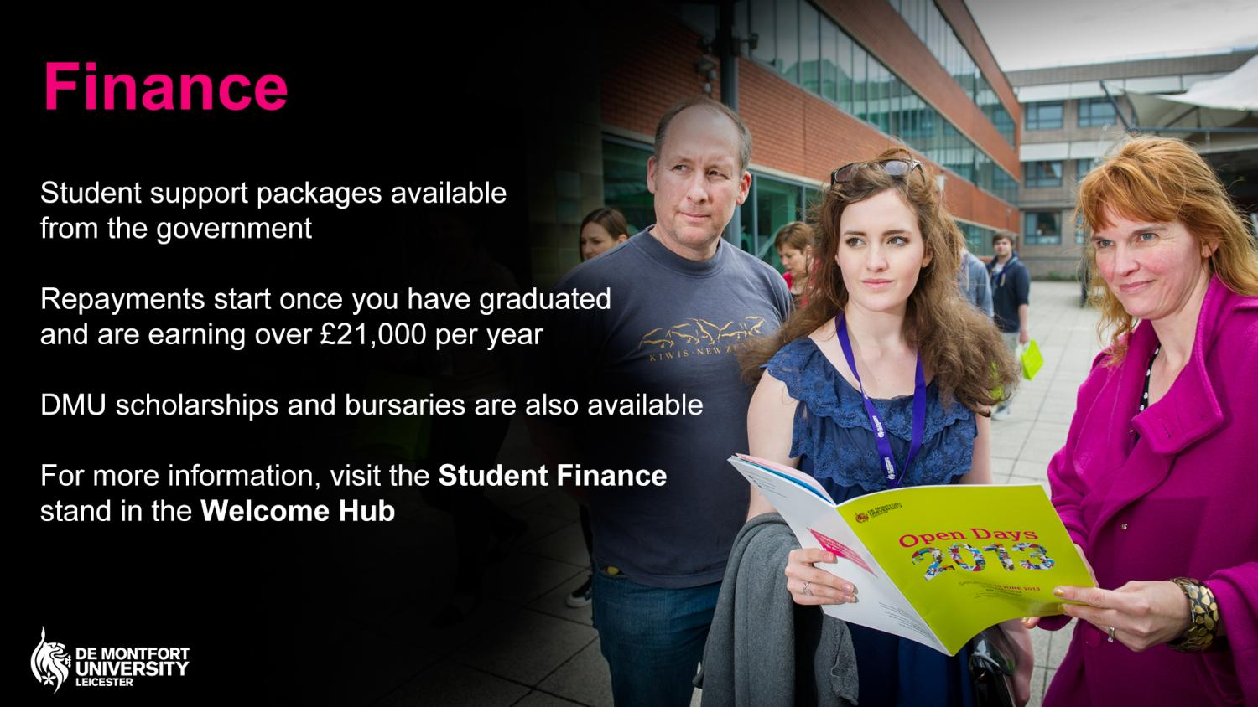
Notes:
As you may be aware, student support packages are available to students via government loans and grants:
Tuition Fee Loans are available to cover full cost of your tuition fee
Maintenance Loans and Grants available to cover living costs
Repayments only start once graduates are earning over £21,000
For more information today: - Attend the Student Finance talks in the Campus Centre Building - Visit the Student Finance drop-in at Gateway House

Slide 8
Notes:
Student activities
DSU Volunteering – 19,645 hours clocked in the community!
Mentoring - with children in care
Sports - 37 competitive sports teams
Twilight sports - Evening – non competitive sport
Societies - 94 different societies
Demon Media - NUS Best Student Media 2013
Commercial services
DSU shop - all your branded clothing, supplies, stamps, dry cleaning and much more!
SULet’s - SU-run estate agents
DSU Tech - computer repair service
The Venue - grab a coffee, beer, burger or a £2 breakfast
Support services

Slide 9
Notes:
Just one of many examples
Kate Turton was crowned New Designer of the Year at Britain’s foremost graduate design show in June 2013.
Kate’s bright, bold and stylish prints wowed the judges at the show, which opened held at the Business Design Centre, London.
Being named New Designer of the Year opens doors and previous winners have gone on to work for global names.

Slide 10
Notes:
The novelist, Louis de Bernières is a DMU Alumnus - he did the Postgraduate certificate in Education
David Shrigley, Turner Prize nominee and commissionee for the Fourth Plinth
Ken Shuttleworth designed the Copper Box in the Olympic Park.

Slide 11
Notes:
Some of England’s greatest rugby players are soon to be interviewed by a Joe Hall a PhD student to record their memories for posterity for the World Rugby Museum at Twickenham.
Joe is a student in our International Centre for Sports History and Culture. He interview former internationals who played between 1945 1995 as part of his PhD project.
We also have partnerships with Hewlett Packard, Leicester City Football Club, Leicester City Museums Service, Deloittes etc etc

Slide 12
Notes:
We hold many events throughout the year - delivered by, and for, our students which will give you the chance to showcase your work - not just to your family and friends but also to potential employers.
You are welcome to attend as many of these events as you would like so you can see what we get up to. This is an ideal opportunity to see the work that our current students have produced.
Art and Design Degree Show
A showcase of our final year’s art and design work attracting over 4,000 visitors. We invite lots of employers to this, firms which are looking to recruit students to their first jobs.
Art and Design Foundation Show
A showcase of the work by our Art and Design (Foundation Studies) students.
Cultural Exchanges
A prestigious event held annually at DMU, organised by students on our Arts and Festivals Management BA (Hons) featuring guests, speakers and performances from the arts, media, literature, politics and film.
Contributors this year included::
Evelyn Glennie
Melvyn Bragg
Benjamin Zephania -who you can see on the slide, spoke about his diverse career as a poet, novelist, musician, playwright, presenter and actor during DMU's Cultural eXchanges festival.
Free Range
Provides new creative graduates with the opportunity to showcase their work on an international level, presenting the work of thousands of art and design students. DMU Photography and Video graduates exhibit their work here.
Graduate Fashion Week in London
The world’s leading event for fashion graduates, showcasing the work of over 1000 graduates from universities across the UK and includes a Contour Catwalk. Our Fashion Design and Contour Fashion students are selected to exhibit their work here.
New Designers
The UK's prestigious graduate design exhibition, with over 3,500 of the most talented, newly graduated designers from the UK universities. Many of our design and fashion graduates experience the opportunity to exhibit at this event at the Business Design Centre in London.
Performances
Exit Souls us a showcase by Drama Studies students from all three years of study. There are other Drama productions too which have included work such as Three Lives of Lucie Cabrol adapted from John Berger's short story, Testing the Echo. by David Edgar, Nights at the Circus adapted from the novel by Angela Carter.
Glorious Collisions is our end of year showcase by our Performing Arts students and the University Dance Festival is performed by final year Dance students at Curve Theatre.

Slide 13
Notes:
We know how important it is that our degrees provide you with the knowledge, understanding and skills that make you attractive to prospective employers. That will help you stand out from the crowd so we put a lot of effort into what we call employability.
We offer excellent placement and work experience opportunities, and the chance to meet and be taught by industry professionals. Graduates can be found working across the world in a huge range of jobs including running Dave’s Leicester Comedy Festival designing clothes for Lady Gaga, designing furniture for Habitat and teaching at schools and colleges across the country.

Slide 14
Notes:
In 2014 DMU won the Guardian University Award for outstanding community contribution through the work of its Square Mile project, which utilises a network of student volunteers and academic experts to run projects that have a positive effect on the lives of people in Leicester. This prestigious award was given in recognition of DMU's commitment to using its knowledge and resources to bring about genuine change for the public good.

Slide 15
Notes:
We have announced a ground-breaking initiative; offering students an international experience to equip them for the fiercely competitive global marketplace. And of course we hope they have a wonderfully rich and eye opening time.
Only 6% of UK university students travel overseas as part of their degree, but through our #DMUglobal programme, we are aiming for 50%.
A pilot project will run in spring and summer 2014 with the full programme rolled out from next autumn.

Slide 16
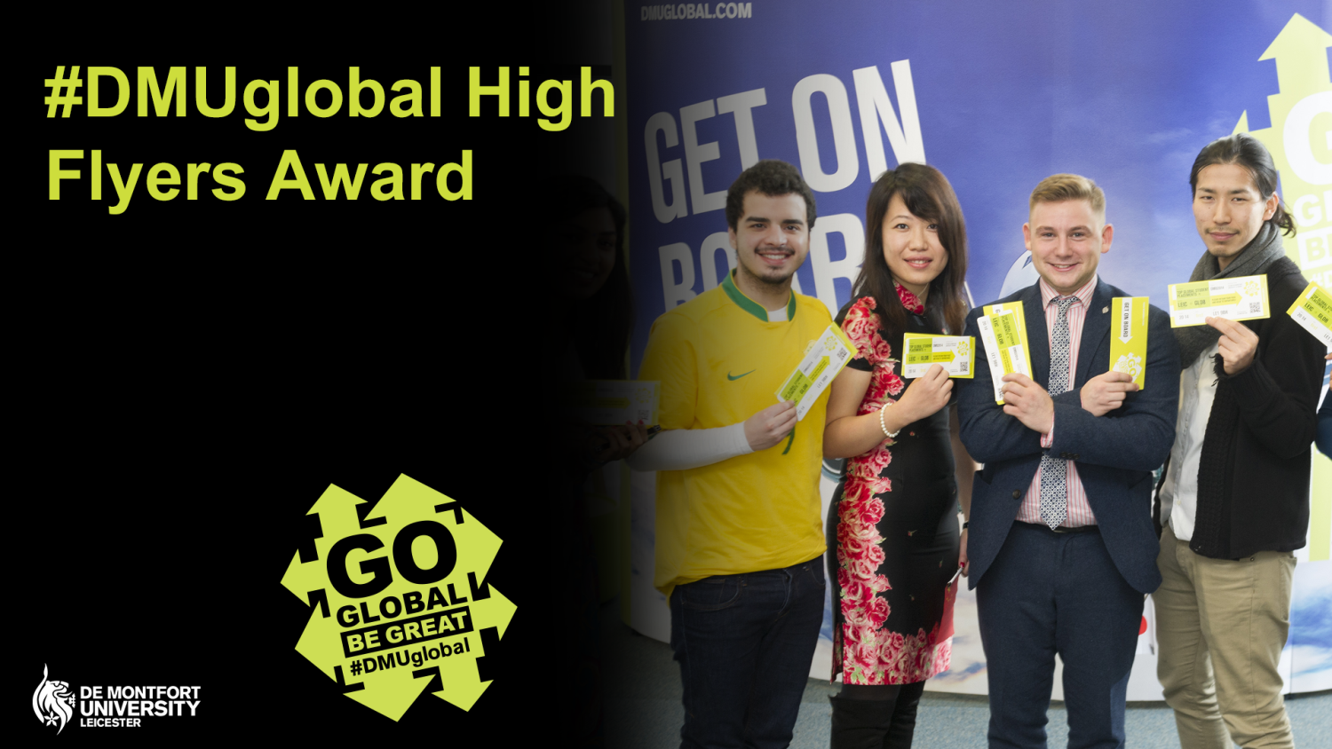
This exciting new award offers ambitious students a £500 discount, redeemable against any #DMUglobal opportunity.
Notes:
Global Scholarship

Slide 17
Notes:
That is just a taste of what we offer you in Arts Design and Humanities. You will be able to find out much more when you go and visit the Schools you are interested in.
Please take this opportunity to have a good look round and to ask anybody anything you like.
And don’t forget to follow us… by going to dmu.ac.uk/socialmedia

Slide 18
Visit the Accommodation Information stand on Campus Centre forecourt
Take a Campus Tour led by one of our student ambassadors
Notes:
We know that finding the right place to live at university, where you will feel comfortable and secure, is vital. That’s why we aim to provide university sourced accommodation for all new UK and international students who request it.
DMU has around 2,100 bedrooms in eight halls of residence, all on or close to campus.
We have a wide selection; en-suite and non-ensuite, over a range of prices and with DMU owned and managed or allocating to privately run halls.
For more information today:
- DMU has around 2,100 bedrooms in eight halls of residence, all on or close to campus.
- We have a wide selection; en-suite and non-ensuite, over a range of prices and with DMU owned and managed or allocating to privately run halls.
- Drop-in to Liberty Park, Newarke Point, Victoria Hall and New Wharf Hall at your leisure anytime between 9.30am-3pm

